Slide 1
CONTROL ANALYSIS OF A TWO-LINK ROBOT ARM
CONTROL SYSTEMS DESIGN PROJECT
Prof. Ashok Kumar Pandey
Authors and Contributions
Bestha Mukesh – ME25MTECH11011 – Research and Report.
Muhammed Shanshad PK – ME25MTECH11012 – Mathematical Modelling of the System
Vidya Sagar Tirandas – ME25MTECH14010 – MATLAB simulation.

Slide 2
Abstract
This project focuses on the control system of a 2-DOF robotic arm consisting of shoulder and elbow joints.
Our project begins with analyzing the robotic arm, its features, mathematical modelling of the arm and finally performing simulation with results discussion.
The aim of the project is to apply the concepts of control systems design to design, simulate and study the stability of the 2 DOF robotic arm.

Slide 3
Introduction and Motivation
Robotic arms are used widely in automation, prosthetics, education and industrial tasks.
By modelling and simulating it, we understand how real robots behave before moving to higher-DOF systems.
A two-link robotic arm is simple but still shows real issues like nonlinearity, joint coupling, and gravity effects.
In this project, we derive both kinematic and dynamic equations and test the system in MATLAB/Simulink.

Slide 4
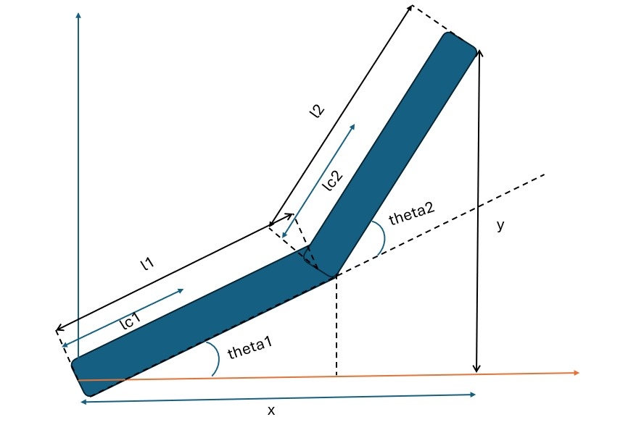
Mathematical Model (Kinematics – Part 1)
Forward Kinematics:
Calculates end-effector position (x, y)
Uses link lengths L1, L2 and joint angles θ1, θ2.
Standard FK equations:
𝑥=𝐿1cos𝜃1+𝐿2cos(𝜃1+𝜃2)
y=L1​sinθ1​+L2​sin(θ1​+θ2​)

Slide 5
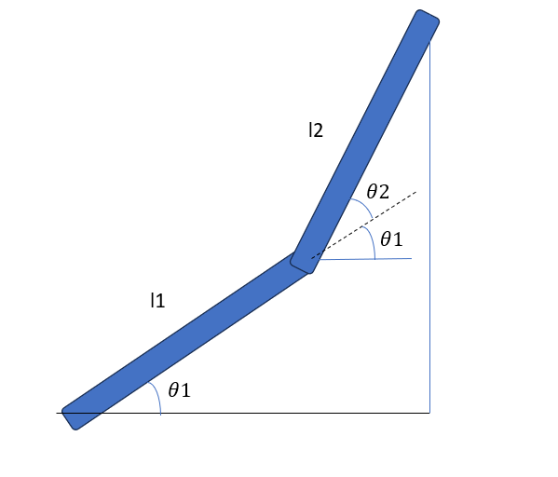
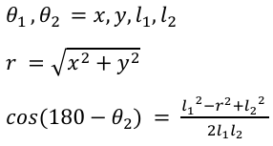
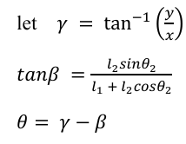
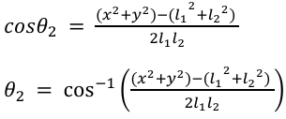


Mathematical Model (Kinematics – Part 2)
Given end-effector position (x, y) and link lengths l₁, l₂.
We have to find $θ_{1},θ_{2}$

Slide 6
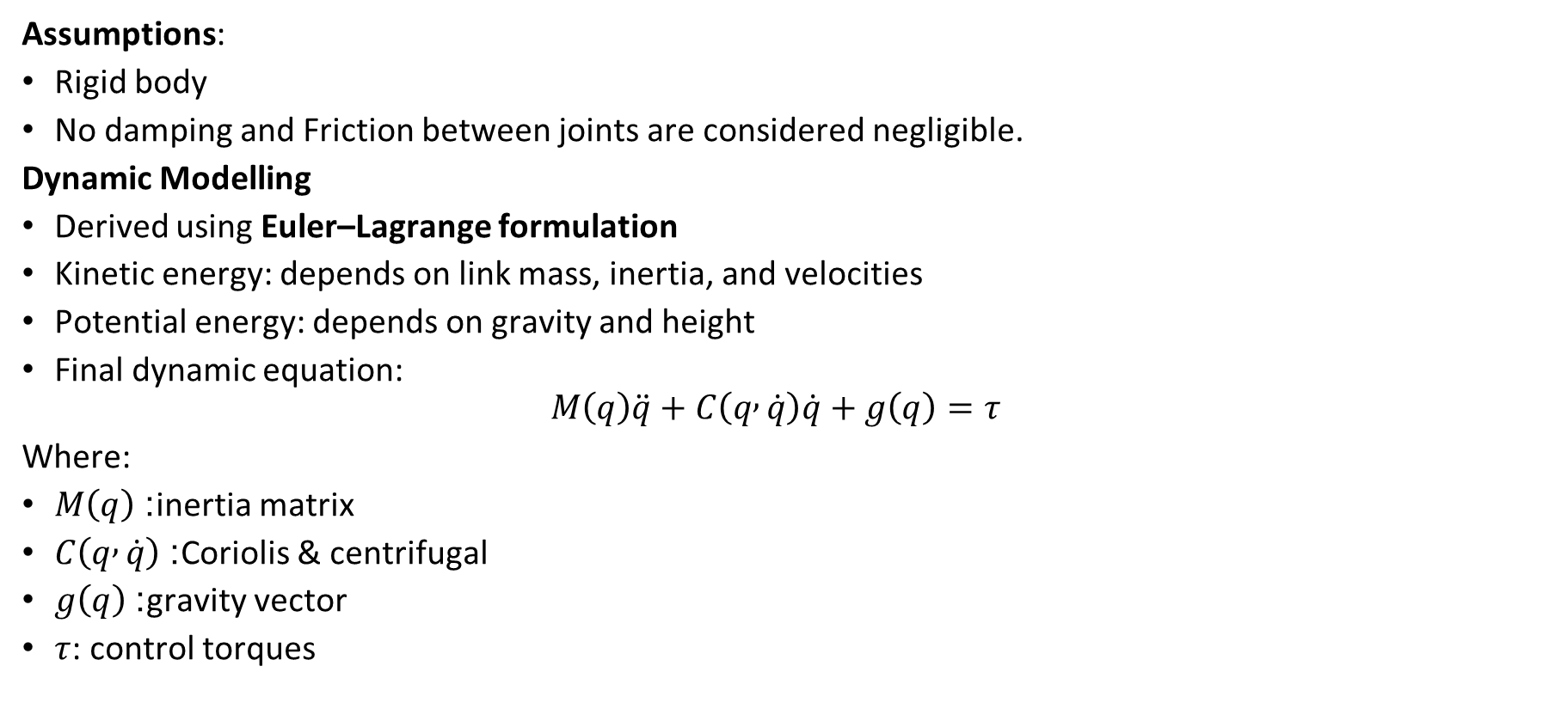
Mathematical Model (Dynamics – Part 1)
Assumptions:
Rigid body
No damping and Friction between joints are considered negligible.
Dynamic Modelling
Derived using Euler–Lagrange formulation
Kinetic energy: depends on link mass, inertia, and velocities
Potential energy: depends on gravity and height
Final dynamic equation:
$$M\left(q\right)\ddot{q}+C\left(q , \dot{q}\right)\dot{q}+g\left(q\right)=τ$$
Where:
$M\left(q\right)$: inertia matrix
$C\left(q , \dot{q}\right)$: Coriolis & centrifugal
$g\left(q\right)$: gravity vector
$τ$: control torques

Slide 7
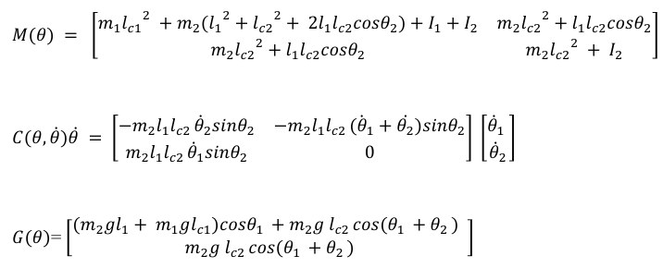
The dynamic behavior of the 2-DOF robotic arm is described by three key components: the inertia matrix, the Coriolis/centrifugal matrix, and the gravity vector. These terms come from the Euler–Lagrange derivation and together determine how the arm moves when torques are applied at the joints.

Slide 8
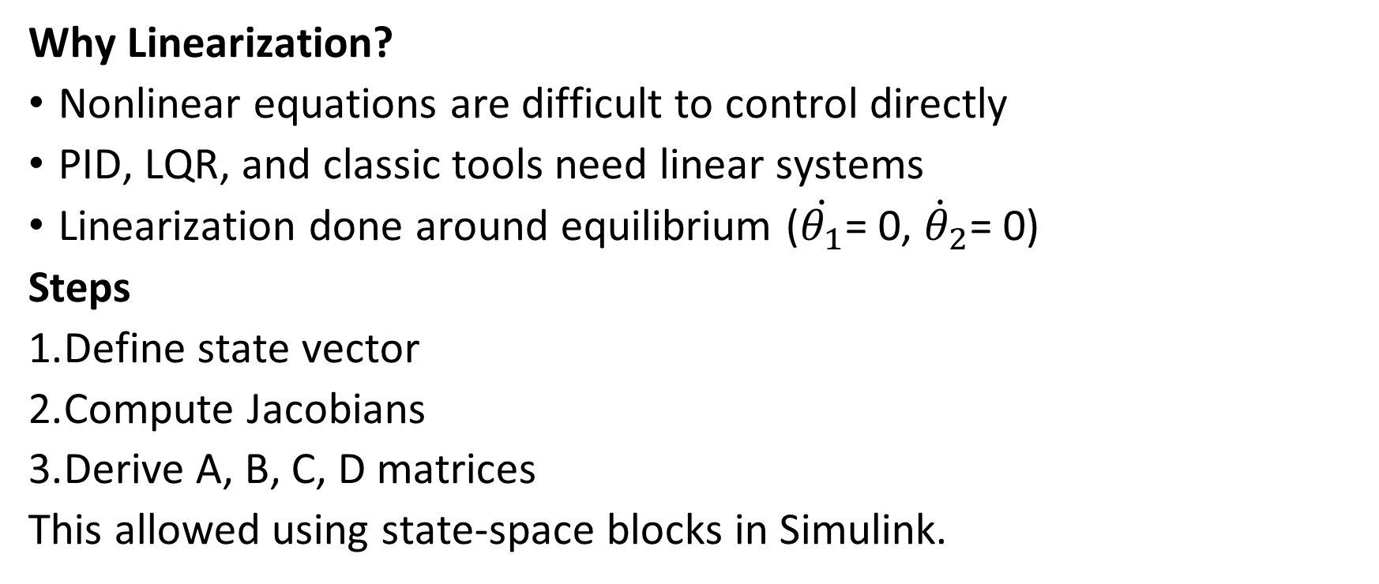
Mathematical Model (Dynamics – Part 2: Linearization)
Why Linearization?
Nonlinear equations are difficult to control directly
PID, LQR, and classic tools need linear systems
Linearization done around equilibrium ($\dot{θ_{1}}$= 0, ${\dot{θ}}_{2}$= 0)
Steps
Define state vector
Compute Jacobians
Derive A, B, C, D matrices
This allowed using state-space blocks in Simulink.

Slide 9
Linearization
The dynamic equations of the 2-DOF robotic arm are non-linear because of trigonometric terms and coupling between joints. These nonlinearities make the system hard to analyze and difficult to control using classic methods.
To simplify the system, we linearize the nonlinear model. Linearization involves computing the Jacobian matrices of partial derivatives from the Euler–Lagrange equations to obtain the A and B matrices of the state-space model.
Non-linear dynamics represent the real behaviour of the robot, but controllers like PID, LQR, and state feedback are all designed for linear, time-invariant systems. So, by approximating the system near an equilibrium point, we can write the robot dynamics in standard state-space form and design controllers analytically.

Slide 10
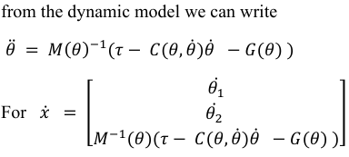
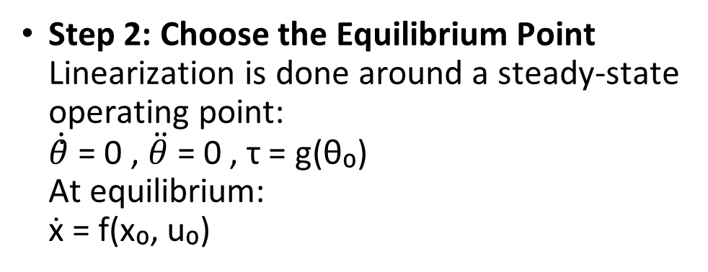
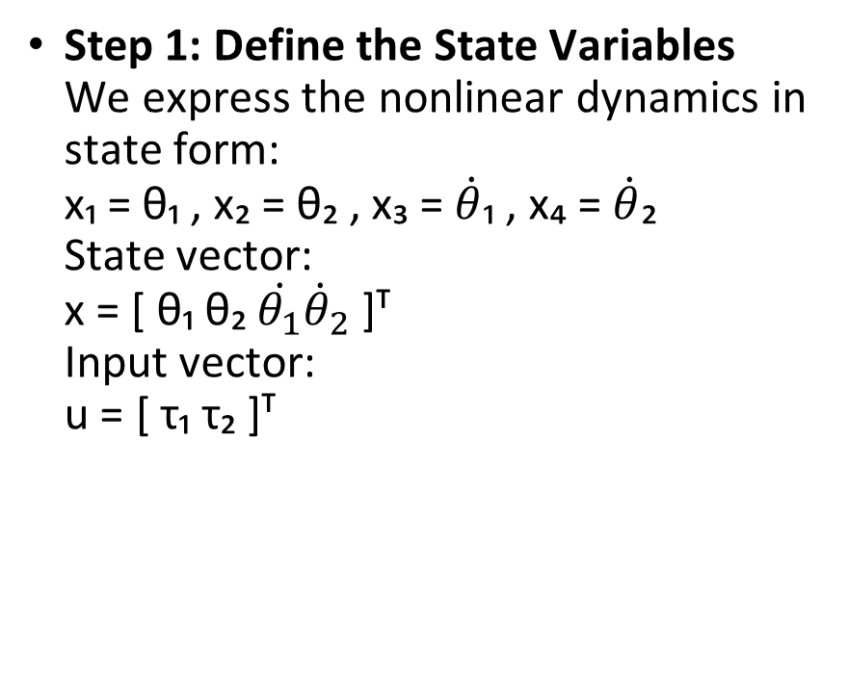
Steps of linearization
Step 1: Define the State Variables
We express the nonlinear dynamics in state form:
x₁ = θ₁ , x₂ = θ₂ , x₃ = $\dot{θ}$₁ , x₄ = $\dot{θ}$₂
State vector:
x = [ θ₁ θ₂ $\dot{θ_{1}}{\dot{θ}}_{2}$ ]ᵀ
Input vector:
u = [ τ₁ τ₂ ]ᵀ
Step 2: Choose the Equilibrium Point
Linearization is done around a steady-state operating point:
$\dot{θ}$̇ = 0 , $\ddot{θ}$= 0 , τ = g(θ₀)
At equilibrium:
ẋ = f(x₀, u₀)

Slide 11
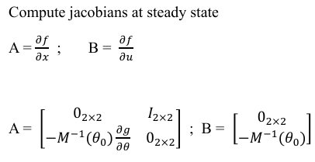
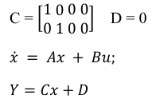
Step 3: Compute Jacobians
We compute partial derivatives of f(x,u) at the equilibrium point to form:
A = ∂f/∂x |₍ₓ₀,ᵤ₀₎
B = ∂f/∂u |₍ₓ₀,ᵤ₀₎
Linear State-Space Model
ẋ = A x + B u
y = C x + D u
This gives a linear approximation of the nonlinear arm dynamics, which can be used to design controllers like PID, LQR, and state feedback.

Slide 12
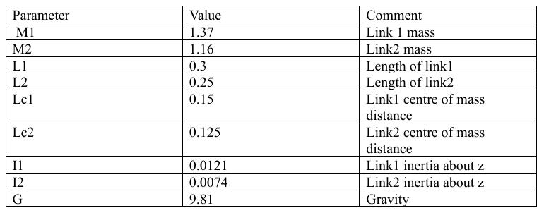
Parameters used

Slide 13
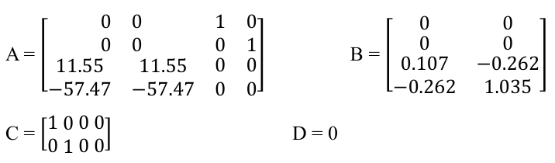
Solutions of the State-Space Equation
After performing calculations, we obtain the following values of A, B, C, D:

Slide 14
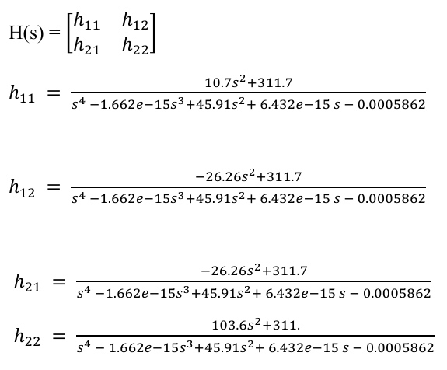

Transfer Functions
Transfer Functions H(s) can be found by using the formula:

Slide 15
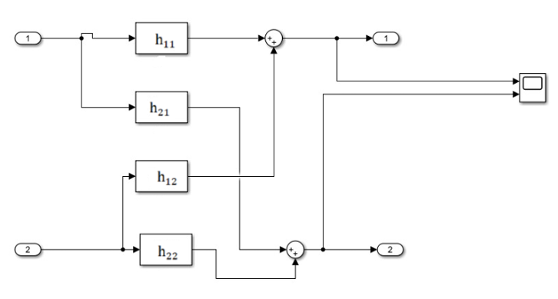
Block Diagrams using the Transfer functions

Slide 16
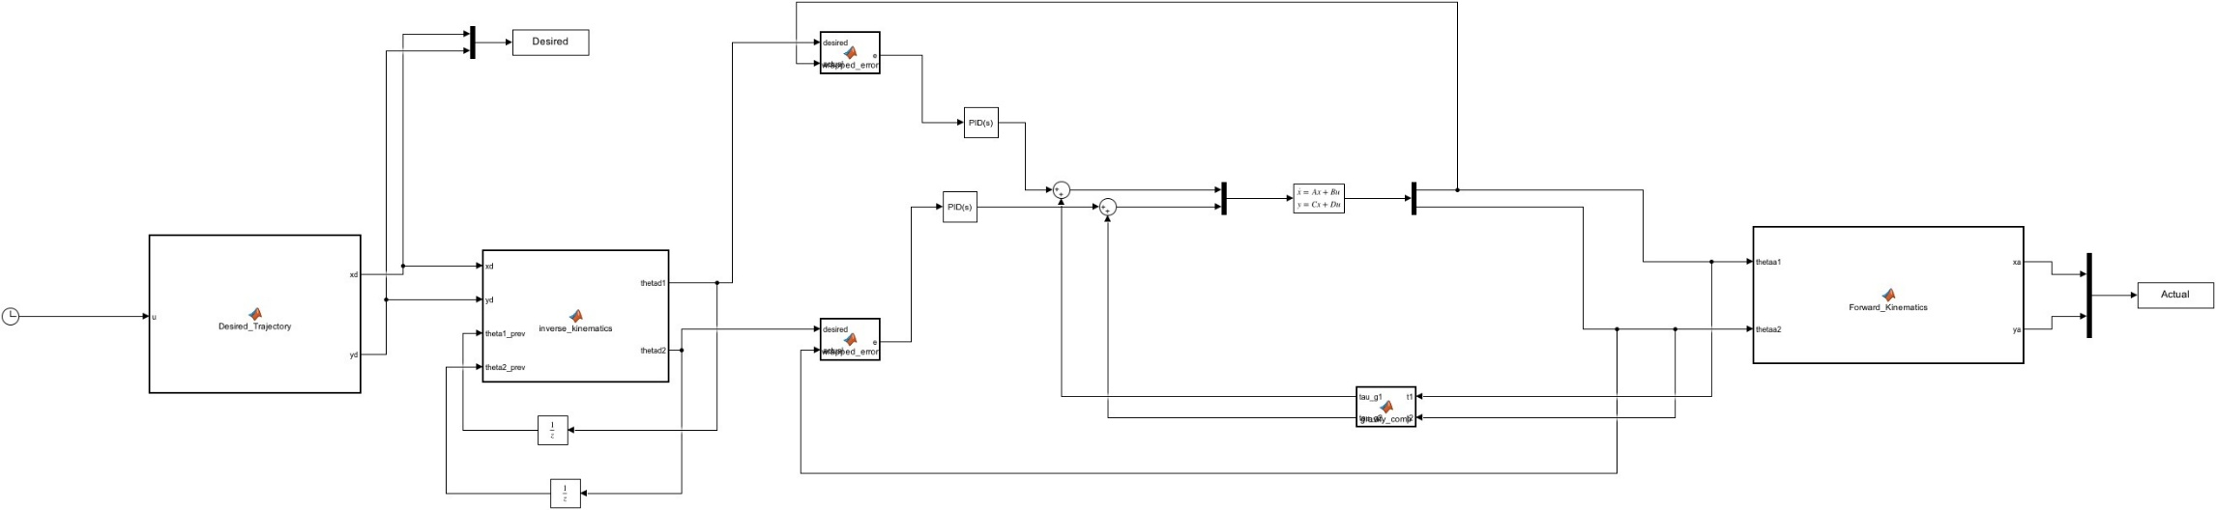

Slide 17
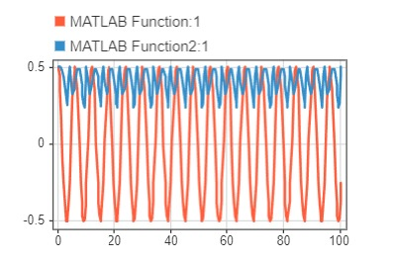
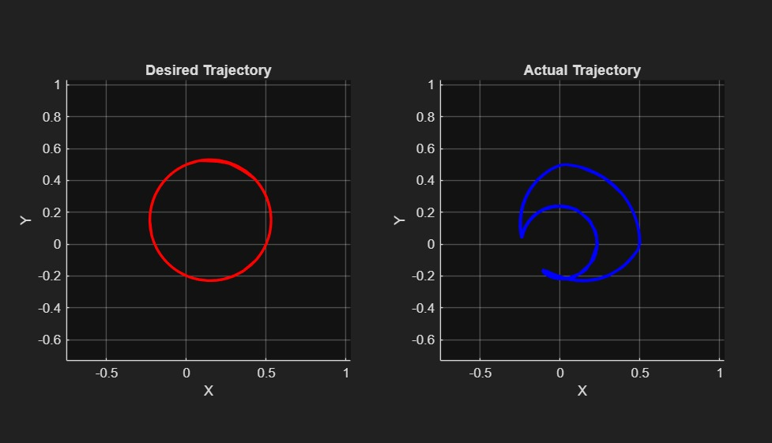
Comparison of desired and actual trajectories before PID tuning and before angle wrapping.
Results and Discussion:

Slide 18
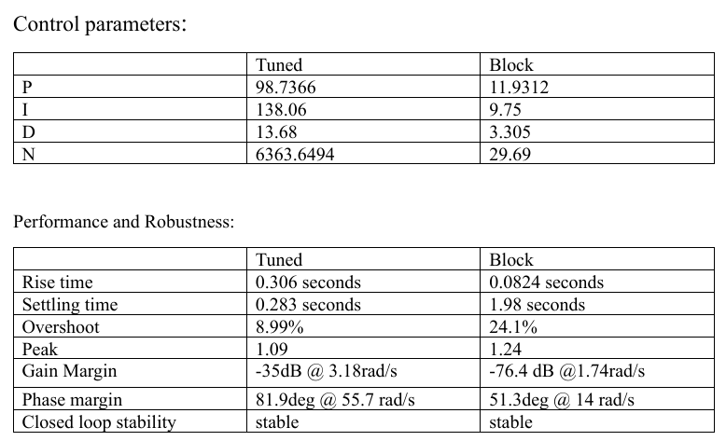
Comparison of System parameters before and after tuning

Slide 19
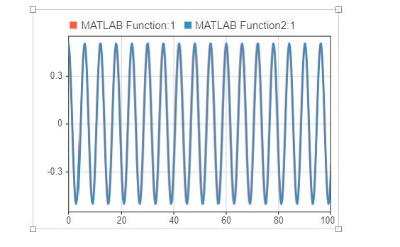
In above figures, MATLAB function1 represents the desired x position and function 2 represents the actual x position, first image is before tuning and the second is after tuning, both merged into one.

Slide 20
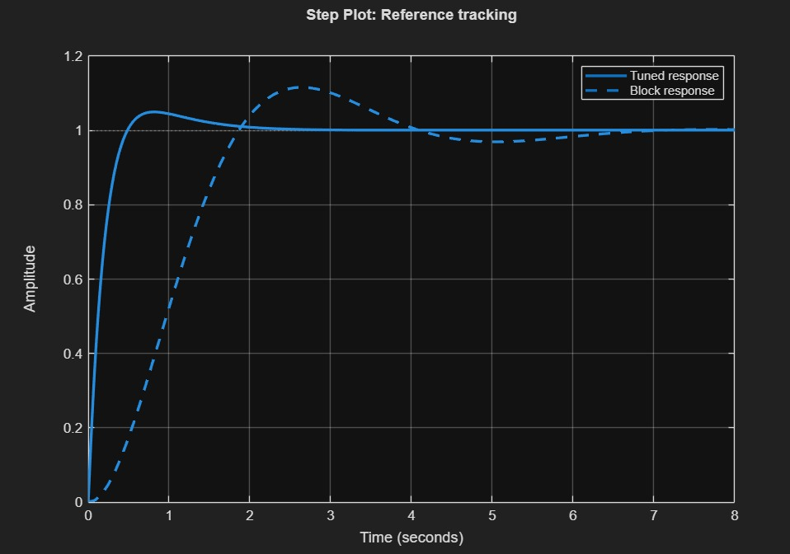
Results & Discussion
Plot for Reference tracking
This plot represents how two control configurations respond to a step input, dashed line represents the block response and solid line represents the tuned response, here tuned response rises quickly to the desired value, it has a slight overshoot but settled quickly. This indicates a well-tuned PID with good stability and faster convergence, whereas the block response rises slowly and has large overshoot because it wasn’t tuned well.

Slide 21
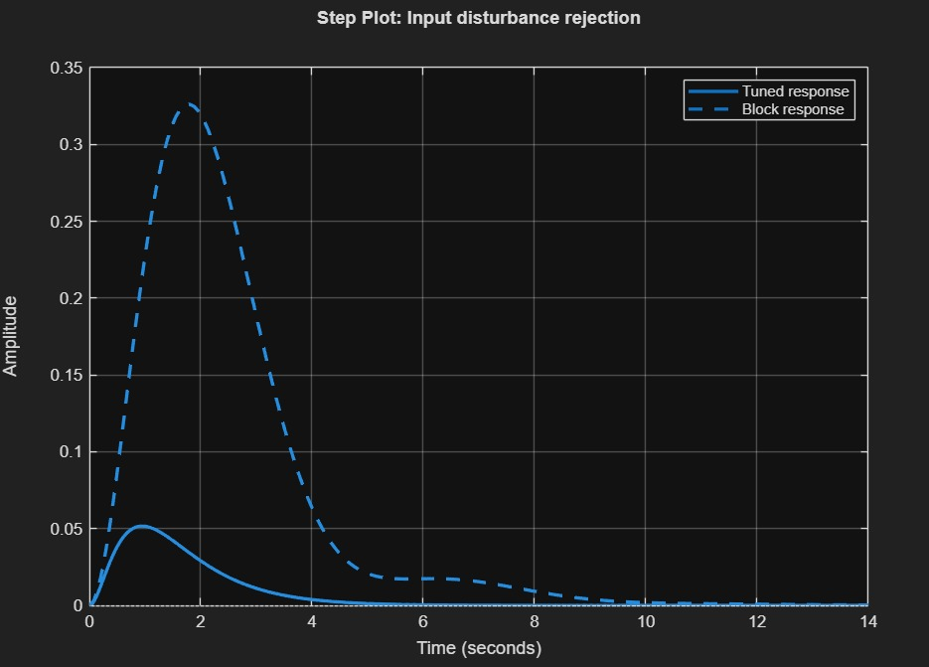
Results & Discussion
Plot for input disturbance rejection
This plot compares how two control configurations respond to unexpected disturbance, such as sudden torque or force applied to the system. Block response shows system reacted more strongly to the disturbance, it is less resistant to disturbance rejection due to not tuning control parameters, solid line represents the tuned response has minimum amplitude indicating more resistant to disturbances because of proper tuning.

Slide 22
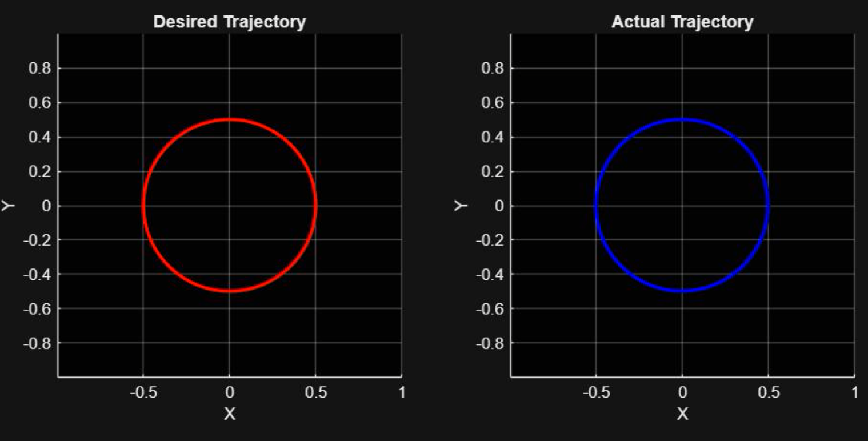
Trajectory comparison:
The figures shown clearly expresses the differences, the first one was before adding angle wrap blocks and the second one was after the angle wrap block was applied, we can clearly see the corrections, improvement in aligning of the trajectory.

Slide 23
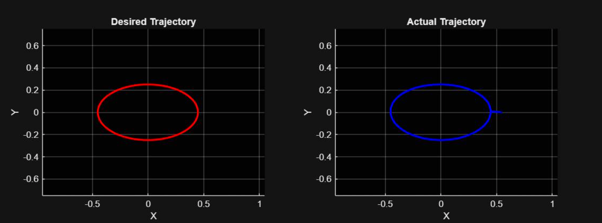
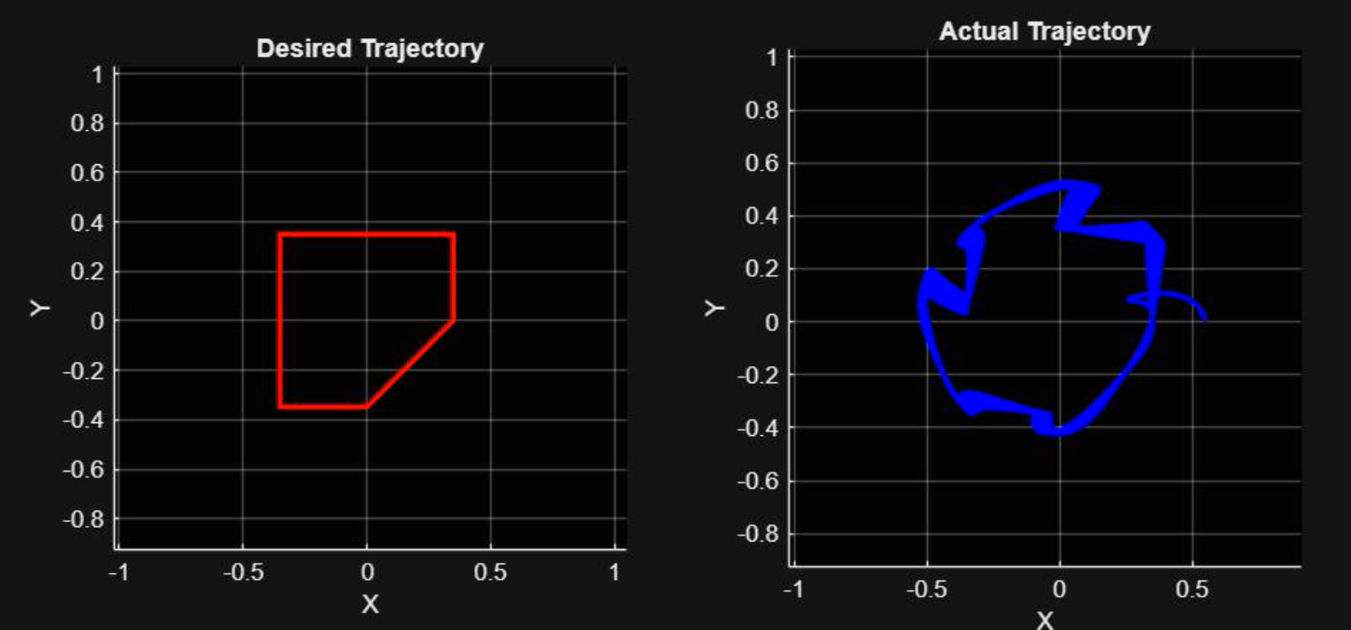
The figures shown are some desired vs actual trajectory shapes after tuning the parameters and adding angle wrap blocks.
The first figure shows the trajectory of an ellipse.
The second figure shows the trajectory of a 4-sided polygon.

Slide 24
Disturbance rejection
A step disturbance was applied at 10 seconds during a 30-second simulation to test robustness. The tuned PID controller remained stable and returned to the desired trajectory for disturbance levels up to ~830 Nm, showing strong rejection of moderate disturbances.
Beyond this level, the system exhibited large deviations, oscillations, and failed to recover due to controller saturation and nonlinear effects of the arm.

Slide 25
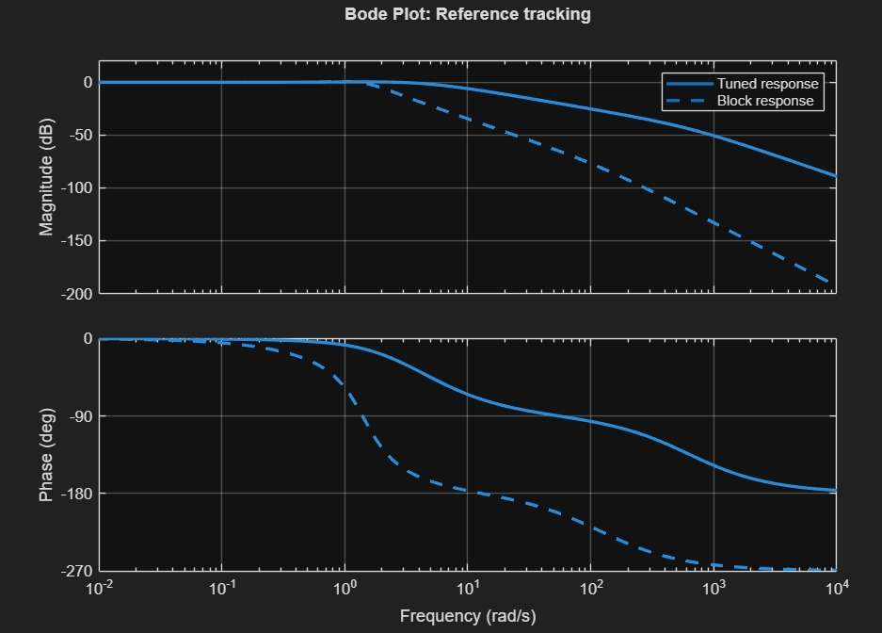
Bode Plot:
The Bode plot compares the frequency response of tuned and untuned control configurations. The tuned response maintains a flat magnitude near 0 dB, indicating consistent tracking across frequencies, while the block response attenuates high-frequency signals, showing poor tracking. In the phase plot, the tuned system exhibits smoother phase variation, suggesting better timing and stability. The block response shows sharper phase shifts, which can lead to delays and instability. Overall, the tuned controller offers superior reference tracking and robustness in the frequency domain.

Slide 26
Conclusion
In this project, control analysis of a 2-DOF robotic arm is done successfully. It was done by deriving its kinematic and dynamic models, linearizing the nonlinear system, and designing a tuned PID controller. Simulations in MATLAB/Simulink were used to test trajectory tracking, stability, and disturbance response. The tuned controller performed much better than the untuned system, showing faster response, improved stability, and strong disturbance rejection. Overall, the study helped us understand how a 2-link robotic arm behaves under control and highlighted the importance of accurate modelling and proper tuning for reliable robotic performance.

Slide 27
References
Mechanical Design, Control, and Laboratory Test of a Two-Degrees-of-Freedom Elbow Prosthesis
Design and Implementation of 2-DOF Arm Manipulator Robot as Robotic Kinematic Learning Platform
Design, Simulation and Control of a 2 DOF Robotic Arm for Correction and Training of Craft Turning
Design and Simulation of a 2 DoF Robotic Arm for TIG Welding
Design and Simulation of a Novel Humanoid Robotic Arm
Parameters Identification Based on PD Controller for A 2-DOF Robotic Arm System
Adaptive controller algorithm for 2-DOF humanoid robot arm Adam Tan Mohd Amina*, Abdul Hakim Ab Rahima, Cheng Yee Lowa,b
Force-Torque Control Implementation for 2 DoF Manipulator
Victor Titov*, I.Shardyko, Sergey Isaenko
Dynamic modelling of 2-DOF luffing mechanism with serial closed kinematic chains
ZHU Zhen-xin1, ZHU Jian-xin1, KANG Hui-mei2, QIAN Huan-yun3

Slide 28
Thank You

